Slide 1
Pre-processing
In-processing
Post-processing
Cascade
Reweighing (RW)
Disparate Impact Remover (DIR)
Prejudice Remover (PR)
Exponentiated Gradient Reduction (EGR)
Gerry Fair Classifier (GFC)
Meta Fair Classifier (MFC)
Grid Search Reduction (GSR)
Equalized Odds Postprocessing (EOP)
10 Pre + In processing
5 In + Post processing
2 Pre + Post processing
10 Pre + In + Post processing

Slide 2
Datasets
Interventions
Metrics
Adult Income
German Credit
COMPASS
Bank Marketing
Pre-processing
Optimized Preprocessing (OP)
Disparate Impact Remover (DIR)
In-processing
Prejudice Remover (PR)
Gerry Fair Classifier (GFR)
Exponentiated Gradient Reduction (EGR)
Grid Search Reduction (GSR)
Post-processing
Equalized Odds Postprocessing (EOP)
Calibrated Equalized Odds Postprocessing (CEOP)
Reject Option Classification (ROC)
Accuracy
F1 score
Accuracy
False Positive Rate difference
False Negative Rate difference
Accuracy difference
Consistency
Statistical Parity Difference
False Discovery Rate Difference
False Omission Rate Difference
Theil Index

Slide 3
In-processing
4
8
12
24
2
3
6
Pre-processing
Post-processing

Slide 4
Pre-processing
In-processing
Post-processing
Debiased
data
Fair
Model
Dataset
ML Model
Predictions
Fair
Predictions
Standard ML Pipeline

Slide 5
Pre-processing
In-processing
Post-processing
Debiased
data
Fair
Model
Fair
Prediction
Dataset
ML Model
Predictions
Evaluation
Fair
Predictions
Standard ML Pipeline

Slide 6
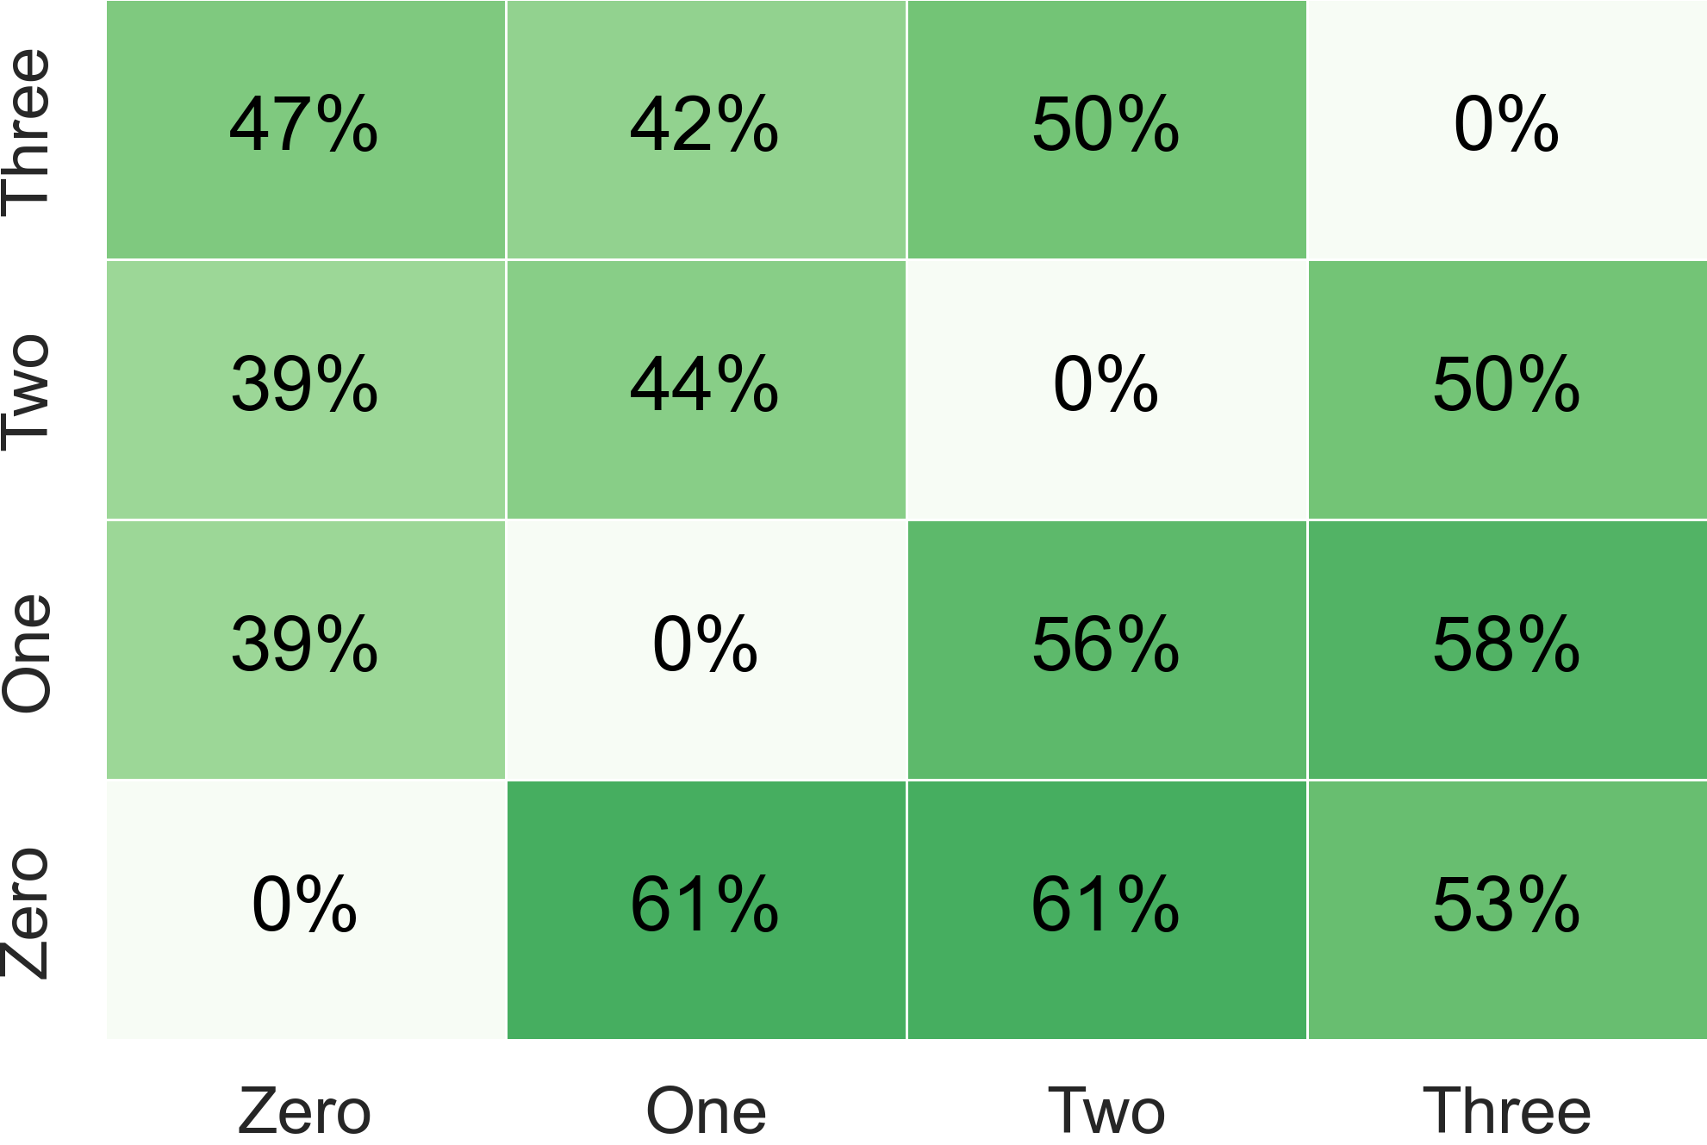
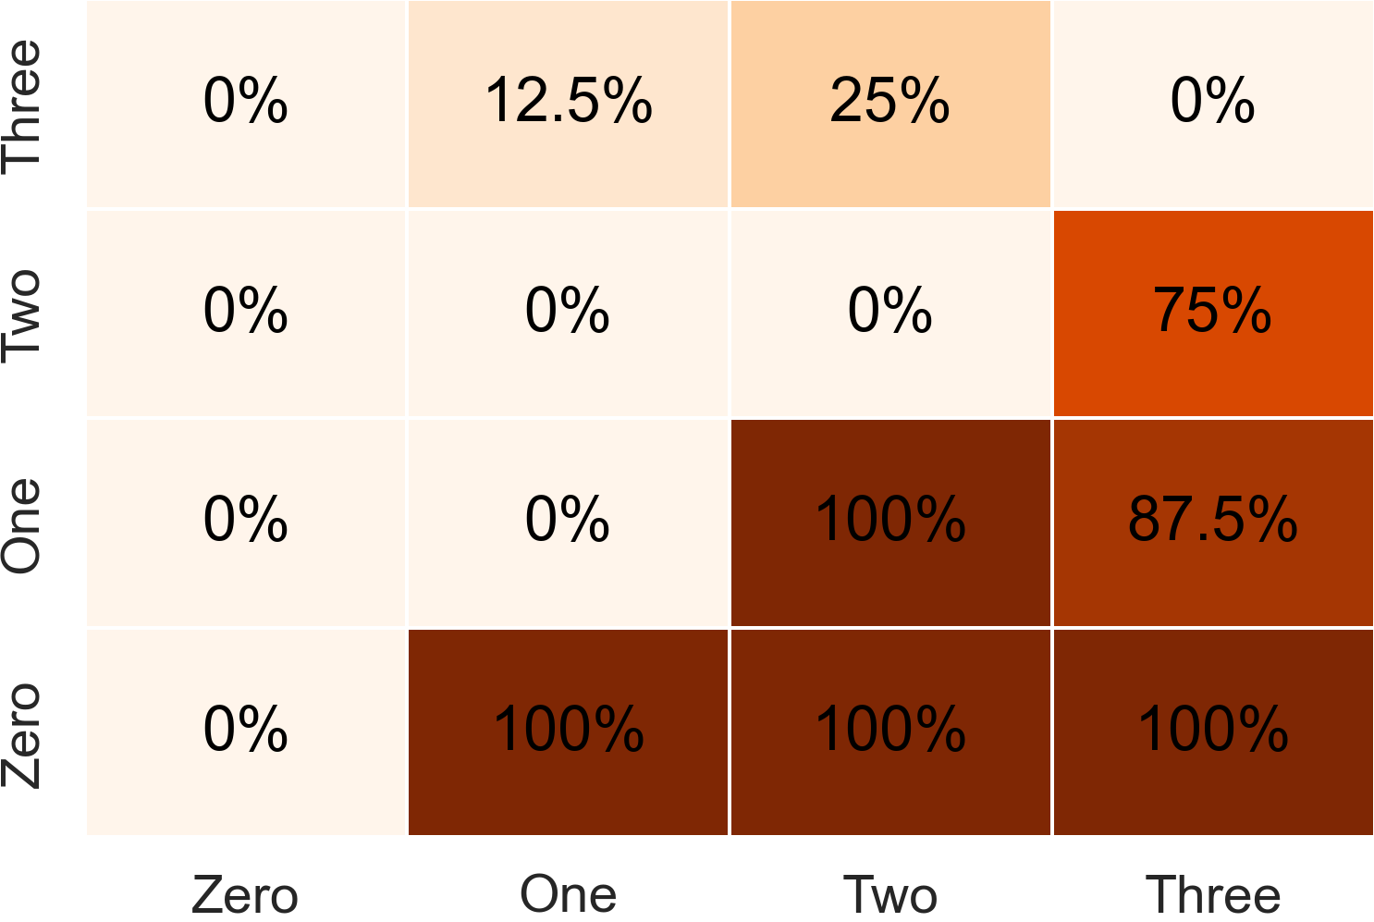
(A) Likelihood of better fairness
(B) Likelihood of worse utility

Slide 7
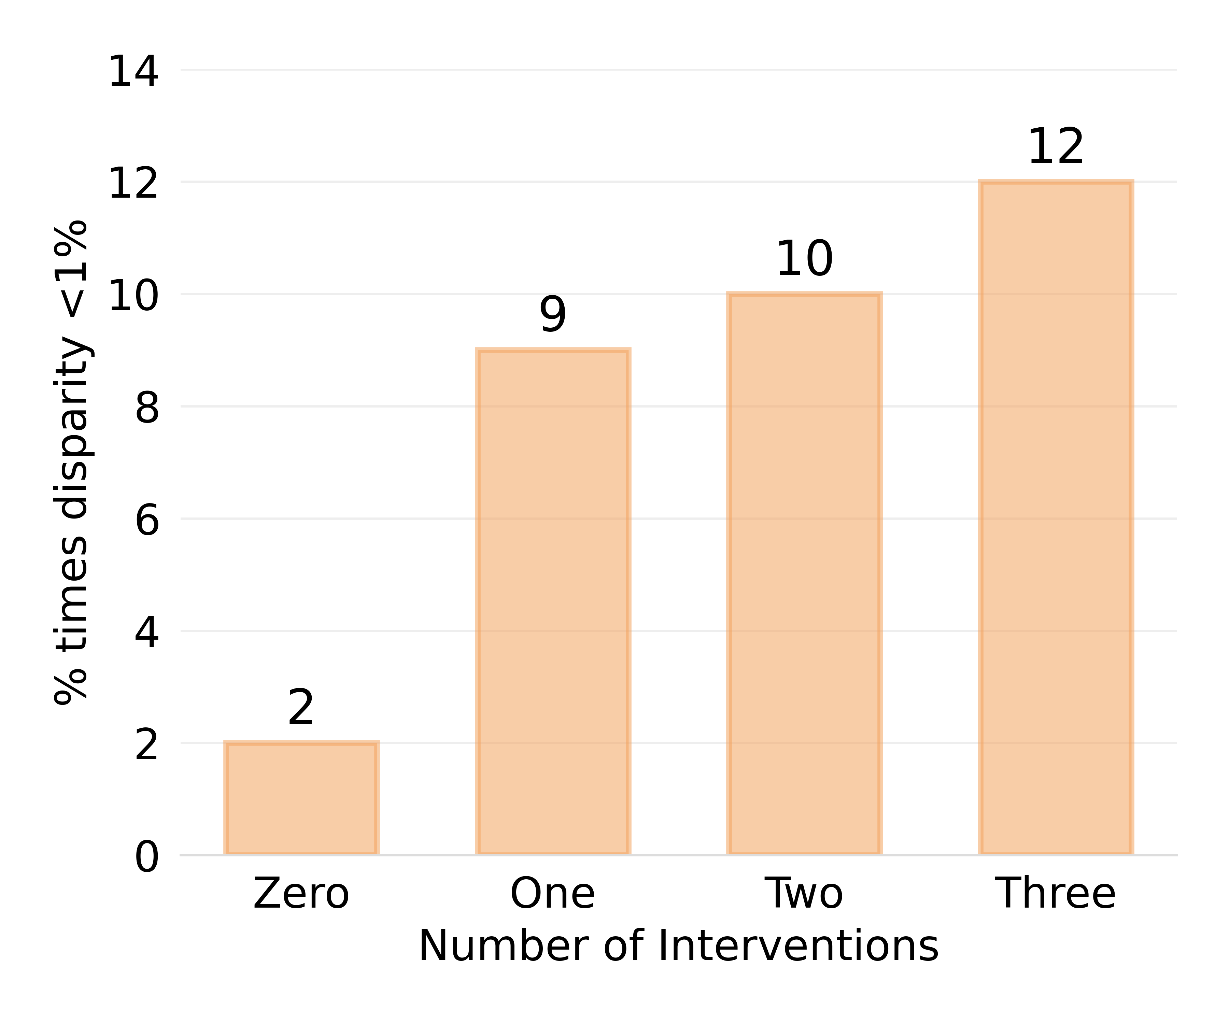
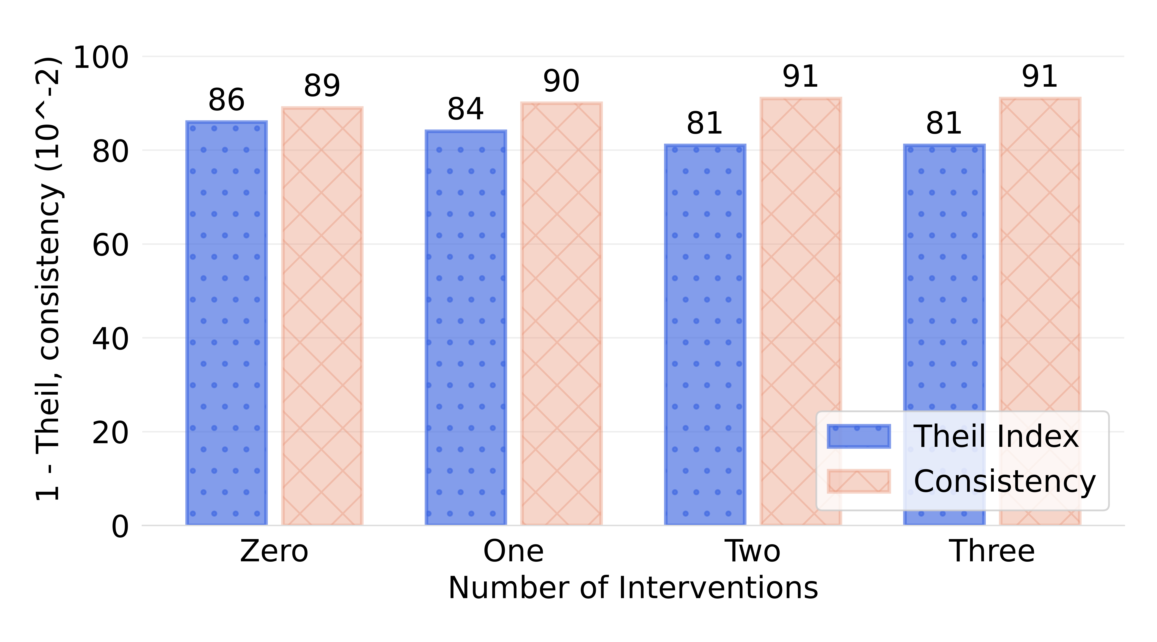
(A) Group Fairness
(B) Individual Fairness

Slide 8
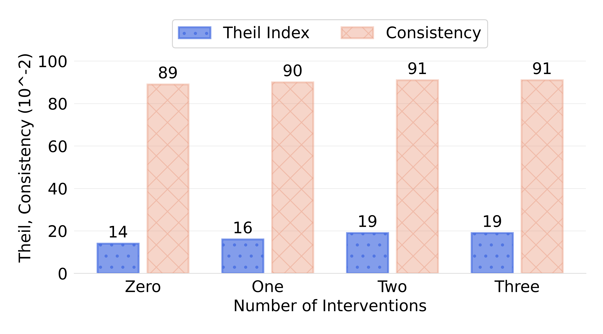
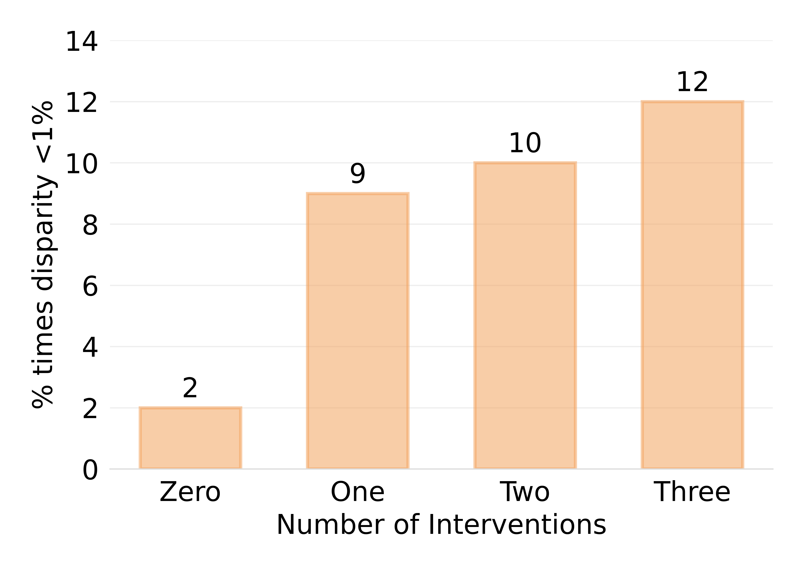
(A) Group Fairness
(B) Individual Fairness

